Slide 1
MIRROR GRIP
Francisco Magalhães - 202005141
Miguel Borges - 202004481
José Teixeira - 202006243
Tomás Cruz - 202008274
Medical Robotics - 2024

Slide 2
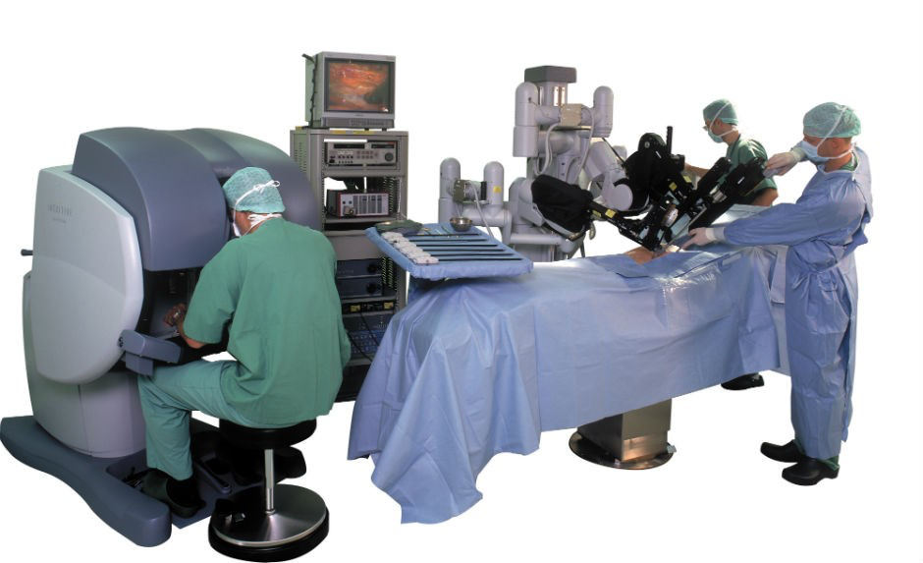
Surgery Robots
Faster recovery
Less blood loss
Minimal scaring
Minimally invasive
[1] https://www.concordia.ca/cunews/offices/vprgs/sgs/public-scholars-18/2018/09/11/surgical-robots-will-save-lives-cut-costs-and-contribute-to-medical-education.html
[2] https://my.clevelandclinic.org/health/treatments/22178-robotic-surgery
Notes:
1985 PUMA 560: The first documented use of a robotic system in surgery occurred with PUMA 560, an industrial robot used to position a needle for brain biopsy.
2000 Da Vinci: one of the most widely known and FDA approved in 2000, allowed the possibility to perform minimally invasive surgeries with its multi-arm design and 3D high-definition vision system.

Slide 3
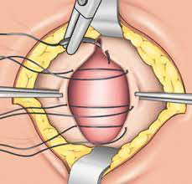
Robot as a Second Pair of Hands
Able to perform menial and repetitive tasks
Holds indefinitely without tiring
Operating abdominal hernia
Notes:
Currently one of the most minimally invasive surgery type procedure is using the laparoscopy methodology.
However, not every patient are eligible to laparoscopic surgery. As a result, there are still several open surgeries being performed.

Slide 4
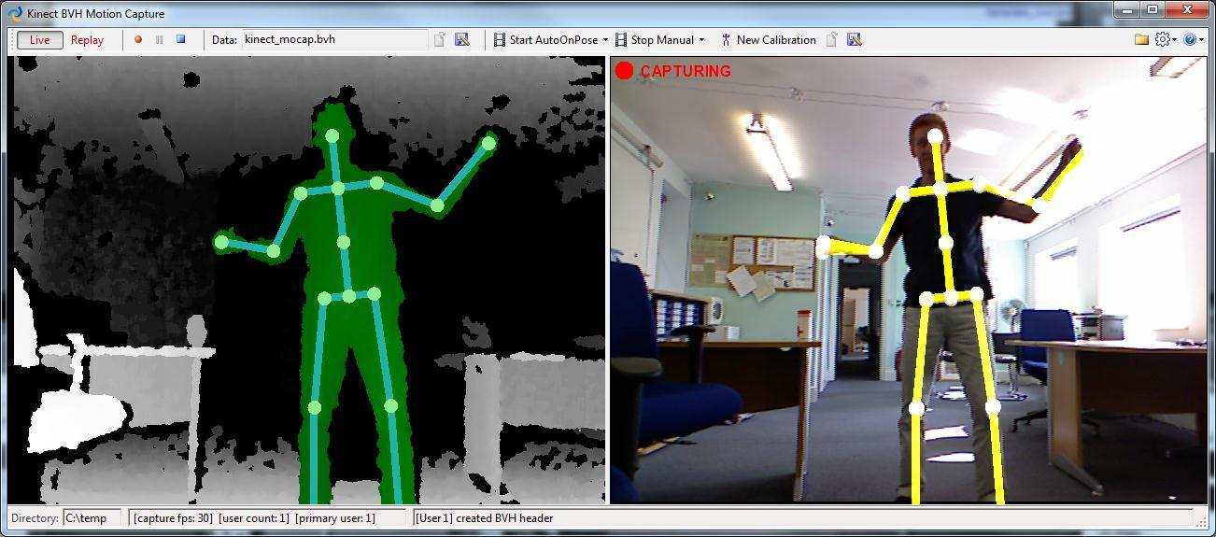
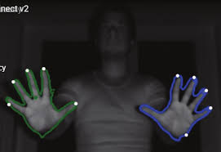
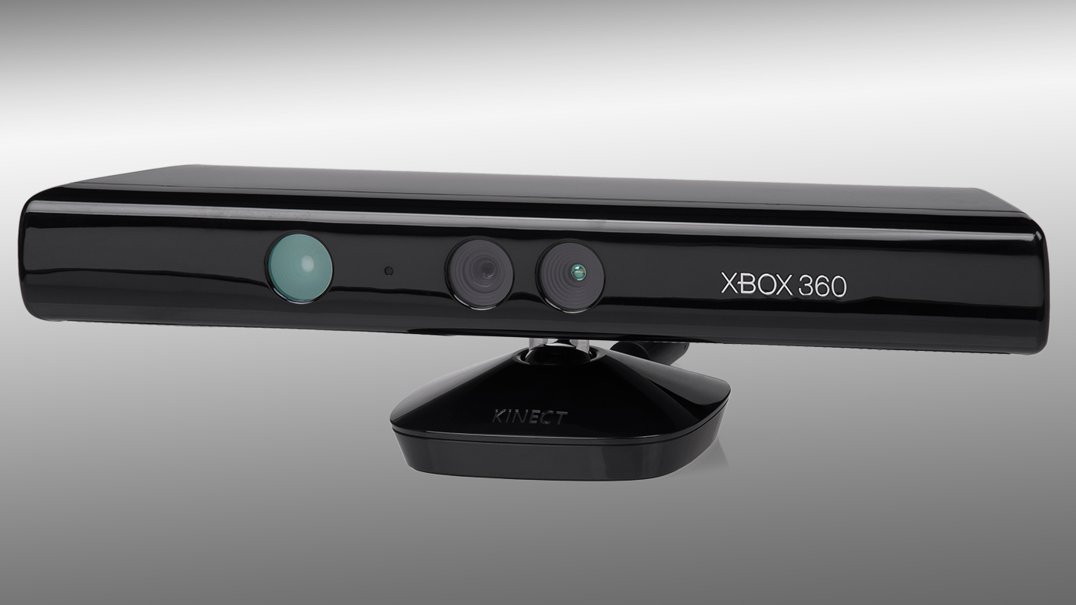
Kinect
Notes:
Device developed by Microsoft that among other features allows the processing of RGB-D images. With this feature we would be able to translate a human joint movement to the robotic arm joint.

Slide 5
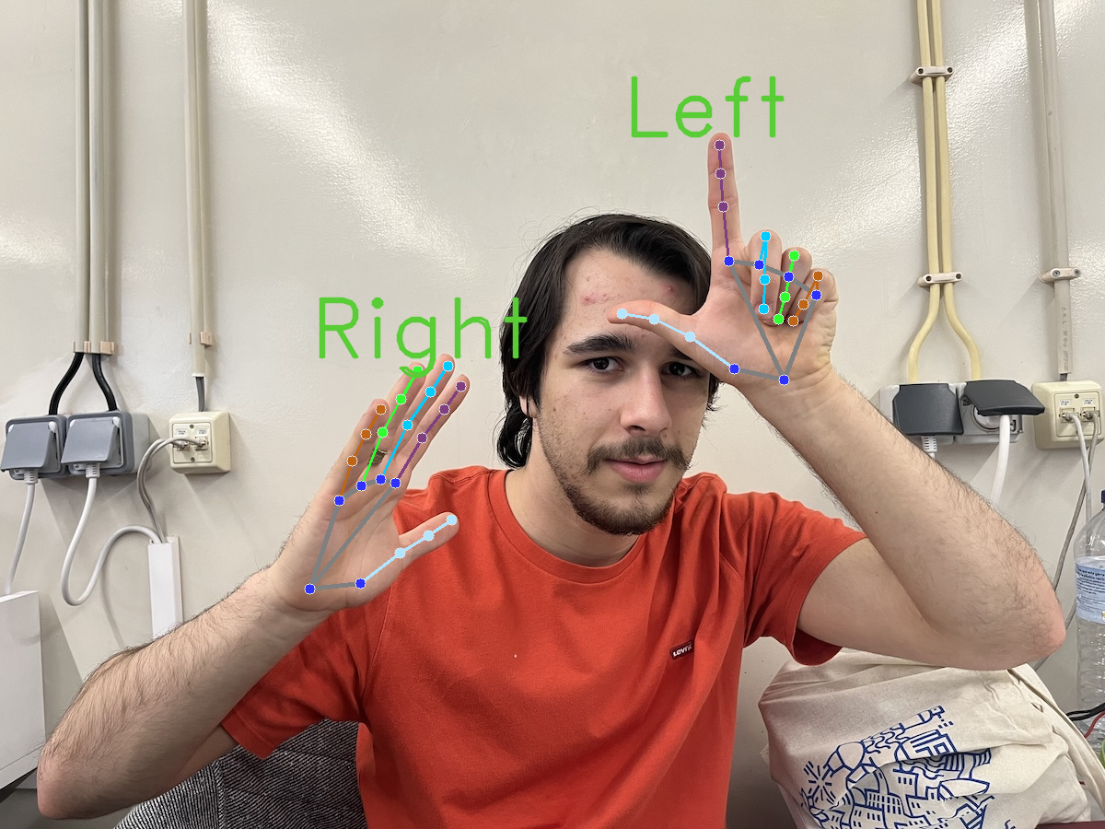
MediaPipe
Hand Landmarker
ML model developed by Google Research that allows to estimate the 3D positions of 21 hand keypoints, distinguishing between left and right hands.
It operates on RGB images and returns the 3D coordinates of the hand keypoints.
The model was trained on approximately 30k real-world images, as several rendered synthetic hand models imposed over various backgrounds
https://ai.google.dev/edge/mediapipe/solutions/vision/hand_landmarker

Slide 6
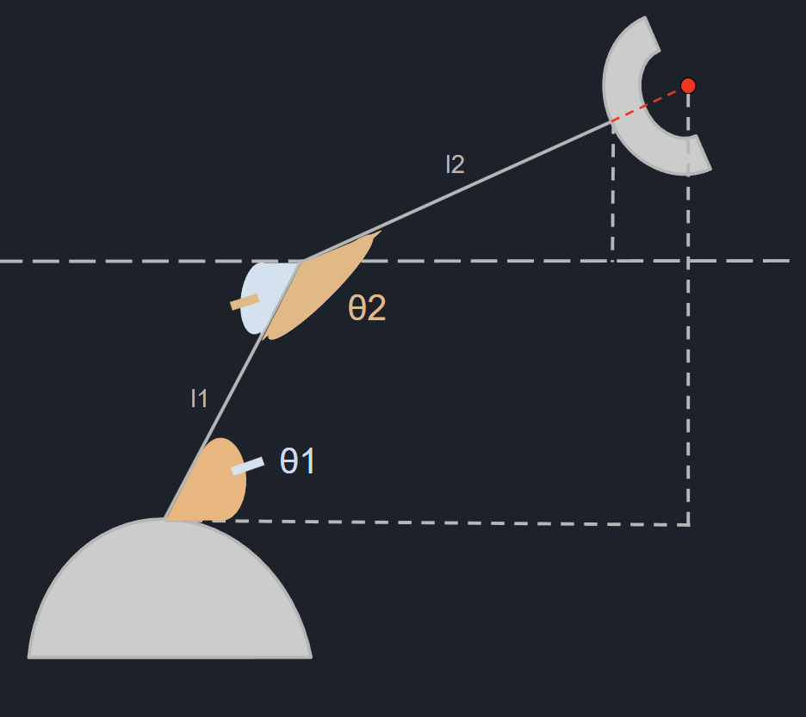
Direct kinematics
Plane x0z:
x = l₁ cos ( θ₁) + ( l₂ + l_{claw} ) cos ( θ₂ - (180 - θ₁))
z = l₁ sin (θ₁) + ( l₂ + l_{claw} ) sin (θ₂ - (180 - θ₁))
Notes:
For this part, simulating the robot at home was crucial to facilitate the development process

Slide 7
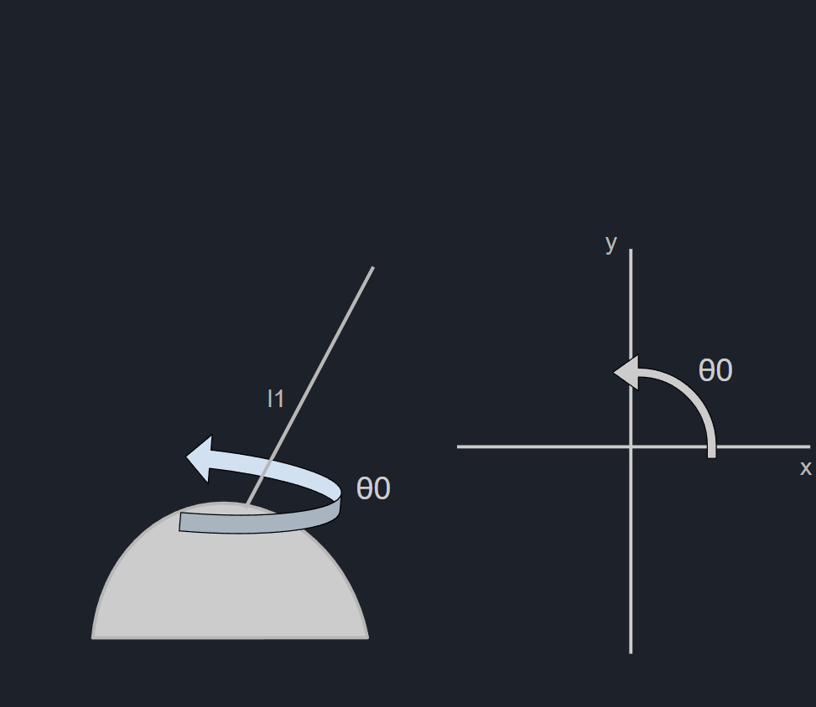
Direct kinematics
Plane x0z:
x = l₁ cos ( θ₁) + ( l₂ + l_{claw} ) cos ( θ₂ - (180 - θ₁))
z = l₁ sin (θ₁) + ( l₂ + l_{claw} ) sin (θ₂ - (180 - θ₁))
With base swivel:
x = cos θ₀ [ l₁ cos ( θ₁) + ( l₂ + l_{claw} ) cos ( θ₂ - (180 - θ₁)) ]
y = sin θ₀ [ l₁ cos ( θ₁) + ( l₂ + l_{claw} ) cos ( θ₂ - (180 - θ₁)) ]
z = l₁ sin (θ₁) + ( l₂ + l_{claw} ) sin (θ₂ - (180 - θ₁))
Notes:
For this part, simulating the robot at home was crucial to facilitate the development process

Slide 8
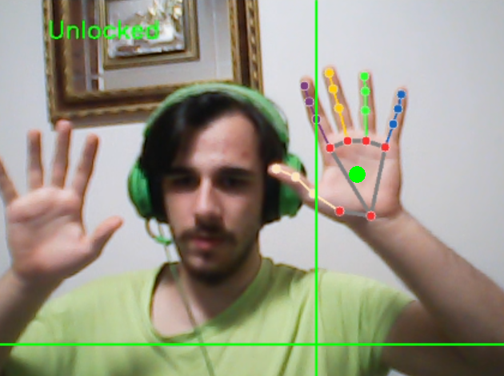
Hand Landmarks & Controls
Claw
Status
Main Hand
Claw
Height
Arm Angle (theta 0)

Slide 9
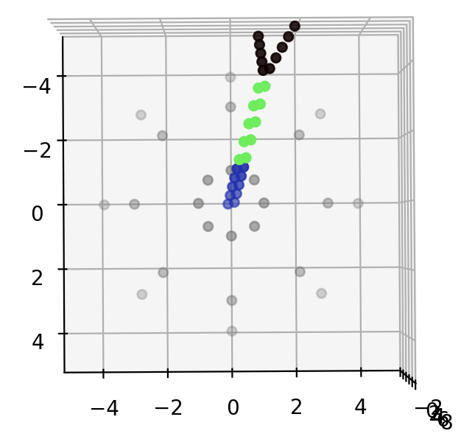
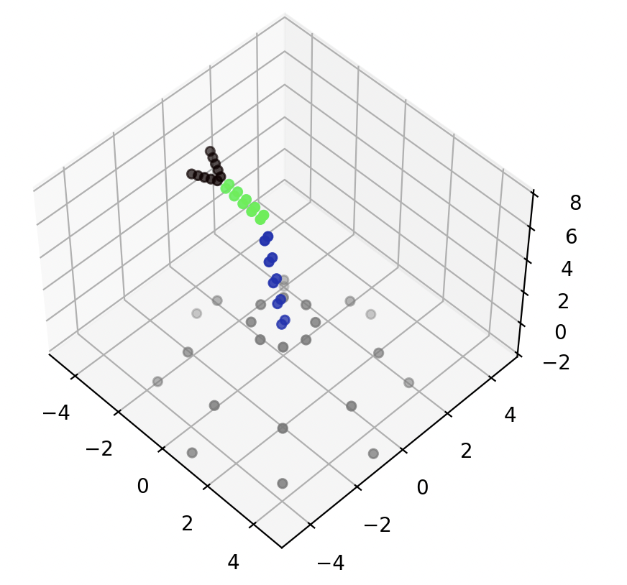
Robot Simulation
Notes:
For this part, simulating the robot at home was crucial to facilitate the development process

Slide 10
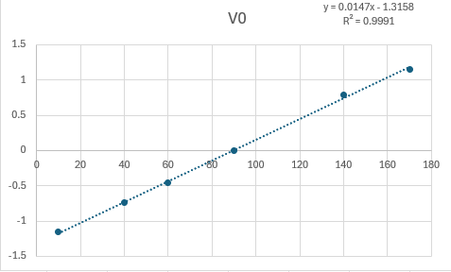

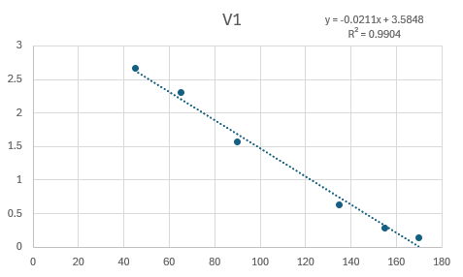
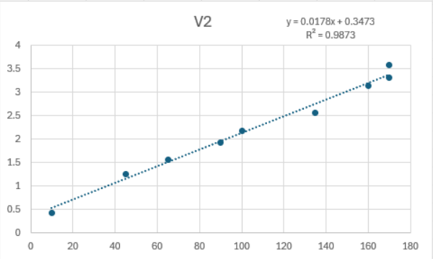
Angles and Movement
Lookup table for Reverse Kinematics
Input V vs Servo Angle

Slide 11
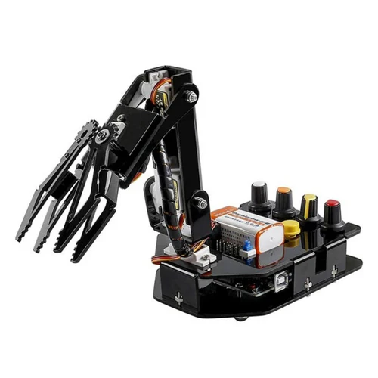
Limitations of the Sunfounder
Imprecise movement.
Susceptible to Inertia.
Arduino does not provide enough current to control the 4 motors.

Slide 12
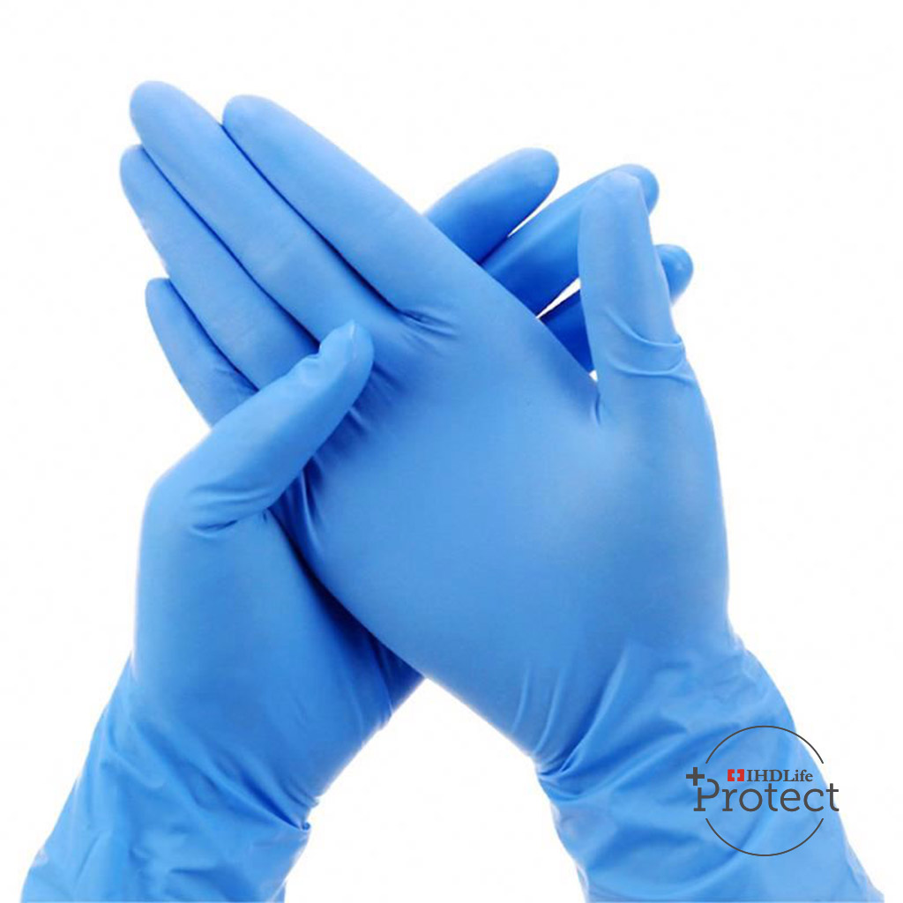
Adjustable Parameters
Supports Left Handed People
Supports Surgery Gloves
Usable with or without console

Slide 13
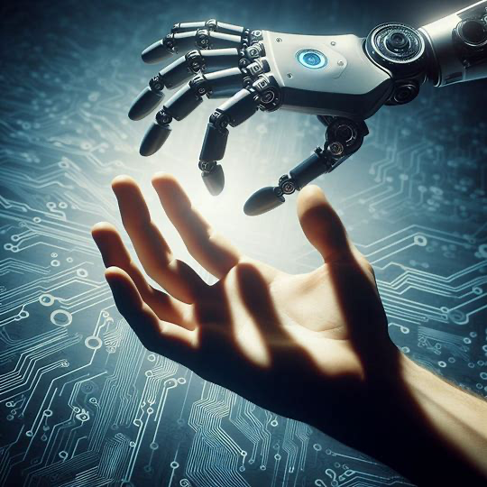
DEMO
So let’s (not) get our hands dirty!

